Slide 1
Urban Micro-Brewery Development Planning
Andrew Cox 5/29/2019

Slide 2
Agenda
Introduction
Data Acquisition
Data Manipulation
Data Analysis and Modeling
Results
Conclusion

Slide 3
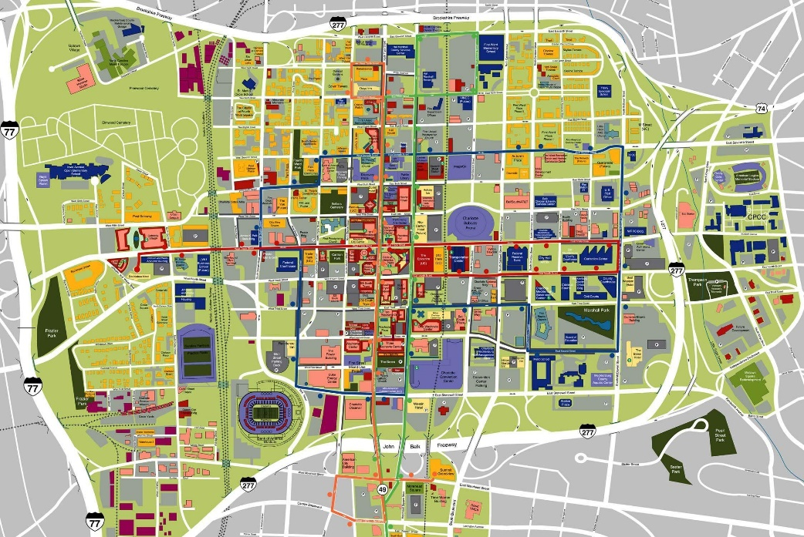
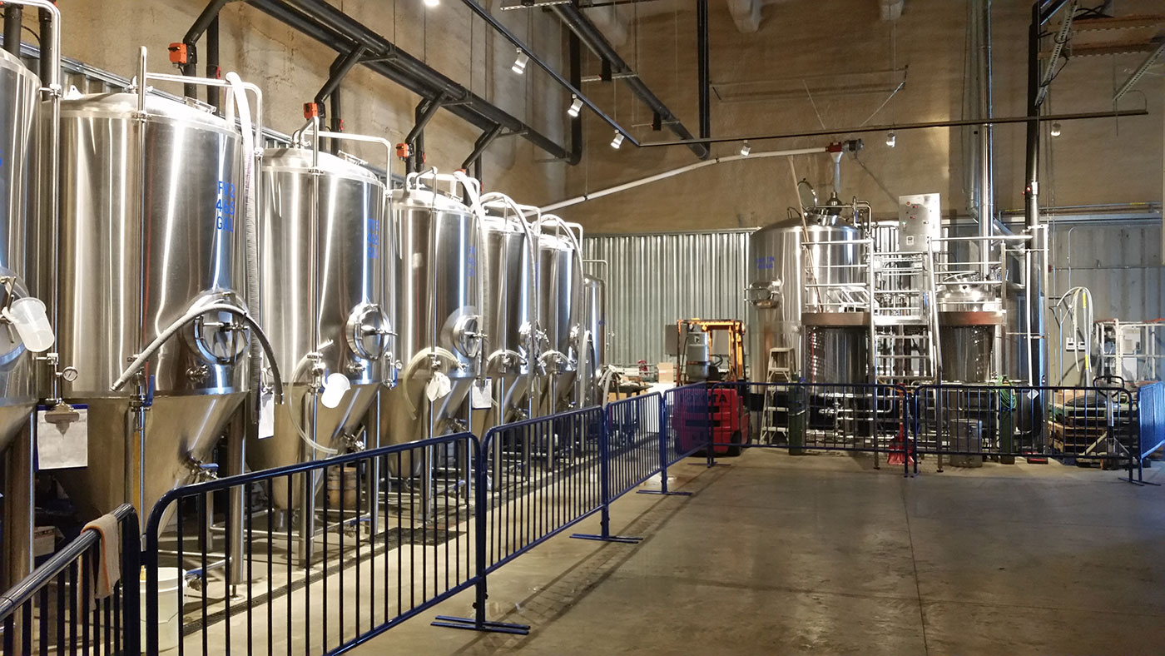
Introduction
Micro-breweries are increasing around the greater Charlotte area.
There are over 40 breweries as of today.
An developer wants to develop an additional brewery and would like to know an optimal location.
An data scientist was asked to help with finding a optimal location.

Slide 4


Data Acquisition
Several data sources were utilized through various methods to capture enough information for analysis.
Foursquare API
Charlotte Area Transportation (CATS)
LoopNet
Google Analytics
Google Maps
Various Brewery Statistic Websites

Slide 5
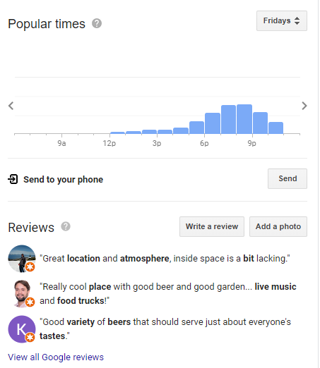
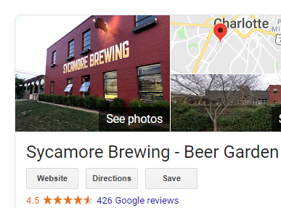
Data Manipulation
We created engineered features to find popular locations at the various venues located at various zip codes.
We then developed a master spreadsheet to calculate the most popular venues based on the day.

Slide 6
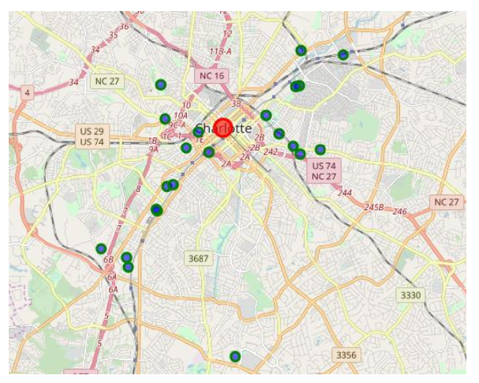
Data Manipulation
We queried Foursquare API to gather brewery locations and filter out all non brewery locations.

Slide 7
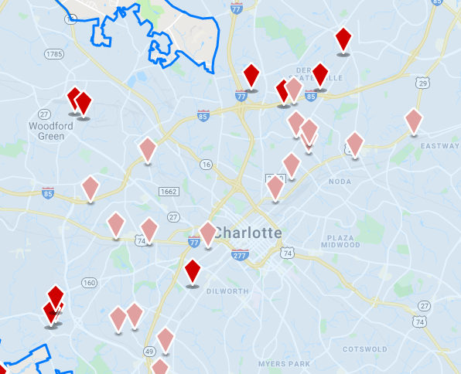
Data Manipulation
LoopNet was utilized for all industrial properties. The properties were based on the clustered zip codes.
All data properties were removed which were <3000 SF as they are too small.

Slide 8
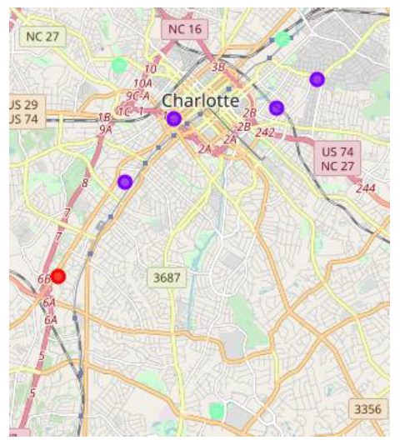
Data Analysis and Modeling
K-Means Clustering (3 Clusters)
K-means algorithm was utilized to identify the dense areas which were already populated with breweries. This would allow for greater customer traffic as the area is already saturated.
I focused on Cluster 1 which is the purple zip codes.

Slide 9
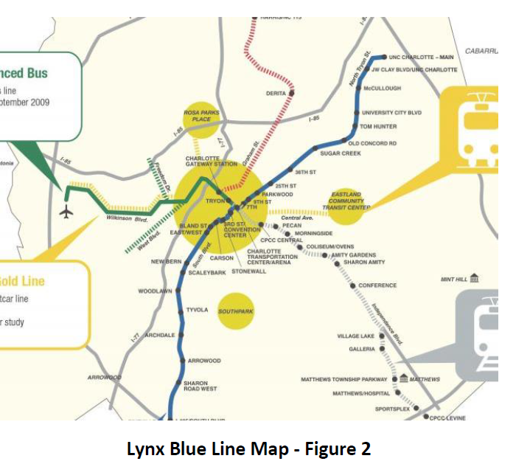
Data Analysis and Modeling
Light Rail “Blue Line”
The light rail stations were used as a benchmark for calculating walking distances to potential properties found on LoopNet

Slide 10
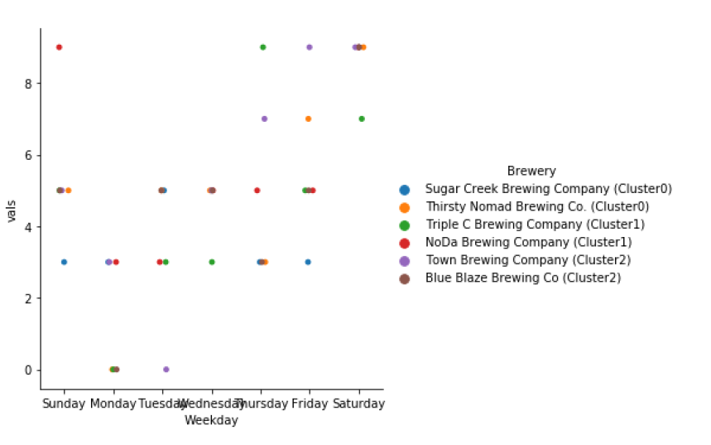
Data Analysis and Modeling
Plotted popular times based on engineered features derived from Google.
A sample was taken of each brewery in the zip code cluster 1 and developed a cat plot of the rankings based on foot traffic.
Cluster 1 had the highest mean score of 5.07.

Slide 11
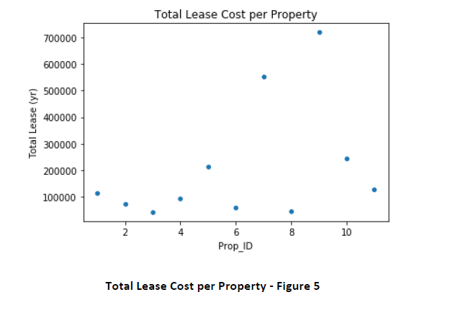
Data Analysis and Modeling
Annual Property Lease Costs
The scatter plot shows the lease cost (yr) for all of the industrial properties around the highly traveled clustered areas.
A property ID was given for ease of identification.

Slide 12
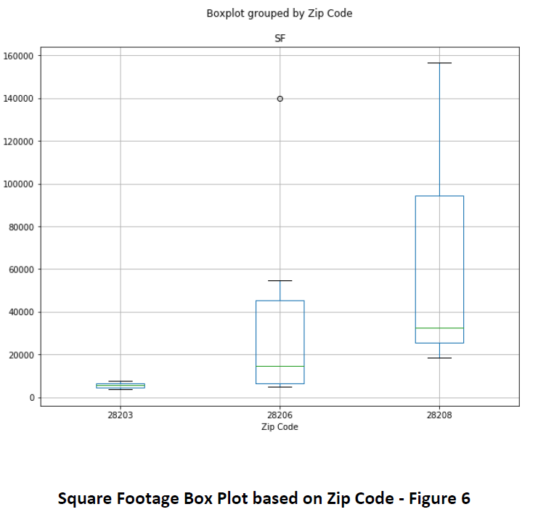
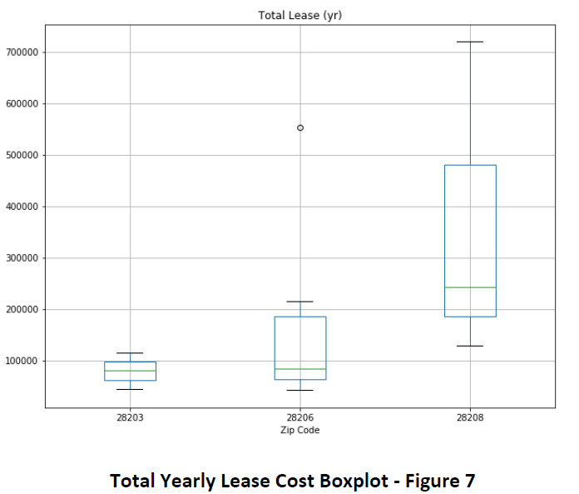
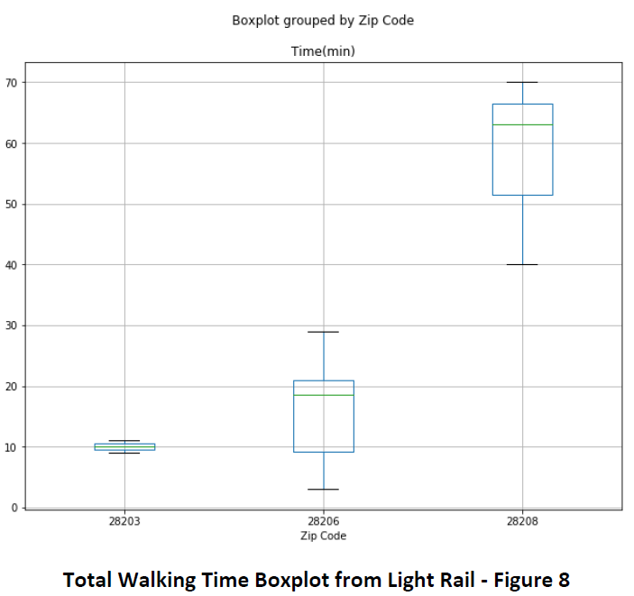
Data Analysis and Modeling
Box plots of Square footage, Total Yearly Lease, and Total Walk Time (minutes).
This allowed us to eliminate 28208 as the walking time to brewery was too great.

Slide 13
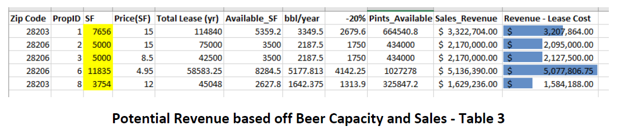
Results
We calculated the potential revenue based on major assumptions in regards to the already narrowed down list of potential properties
We see that property 6 yields the greatest potential revenue based on bbl of beer produced/year, with Property 1 a runner up.

Slide 14
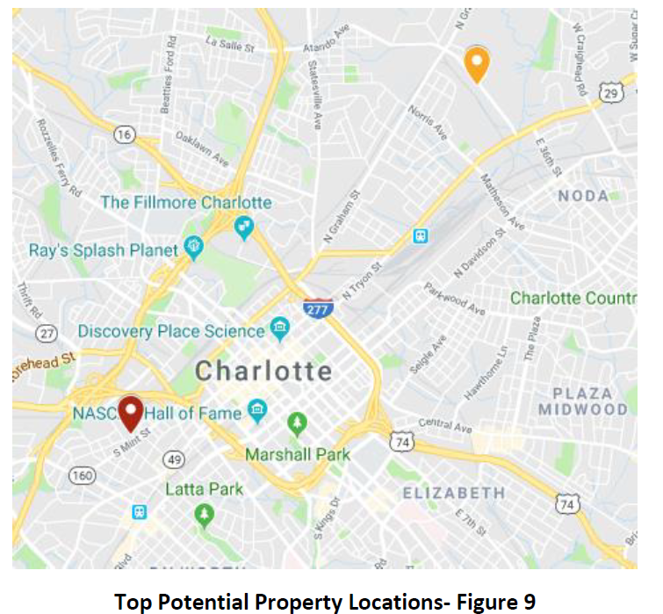
Results
Property 6 (orange) has a walk time of 21 minutes (1 mile) where as property 1 (red) has walk time of 11 minutes (0.5 miles)
Both potential properties are plotted in the Google Map below

Slide 15
Conclusion
We provided several choices for the developer and narrowed down the results to two “primary” potential solutions.
We utilized ML and other statistical analysis’ and visualizations to understand the data we retrieved.
Looking at the current situation, we found that there were no properties available in Cluster 1. This made sense as it is already the highest developed area. This led us to search for properties in Cluster 2.
We built several models and a framework for evaluating several possibilities as to how to determine an optimal property for a micro-brewery.

